Slide 1

Online Shoppers Intention Analysis
By:
Abeer Mohammed Alghamdi

Slide 2
Project Purpose:
Analyze the Customer's Intentions based on the transactions, duration made online in a year.
Create a model that can predict the purchasing intentions of customers.

Slide 3
Data:
The dataset obtained from Kaggle website.
Data set consists of 18 features belonging to 12,330 shopping sessions.
The 'Revenue' attribute is the target feature.
There are no missing values.

Slide 4
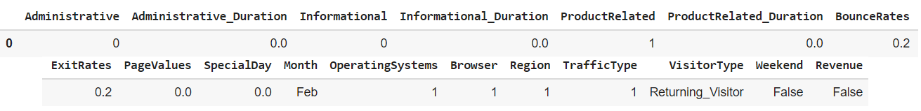
A Quick Look Of Dataset Features:

Slide 5
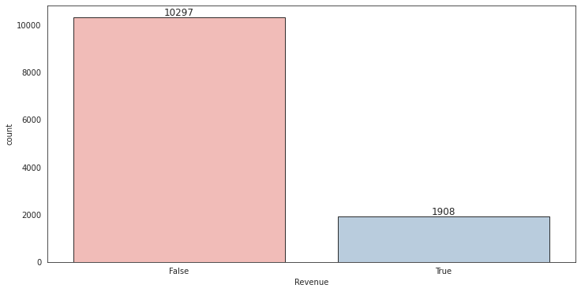

The Key EDA Results:
Revenue Feature:
15.6 % of transactions turned into sales.
84.4% of the transactions did not turn into
sales.

Slide 6
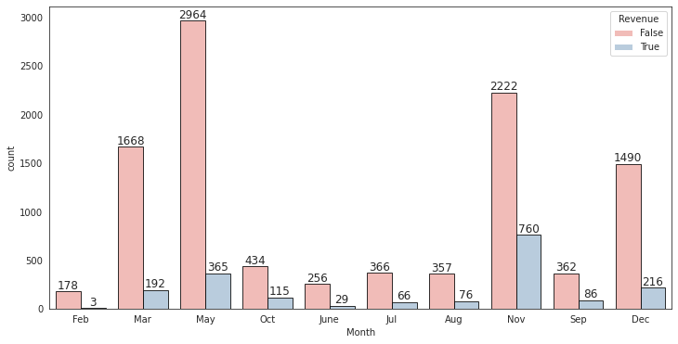
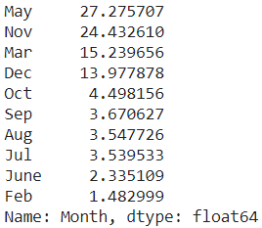
2. Month Feature:
Beyond than 80% of transactions made
on Mar, May , Nov and Dec months.

Slide 7
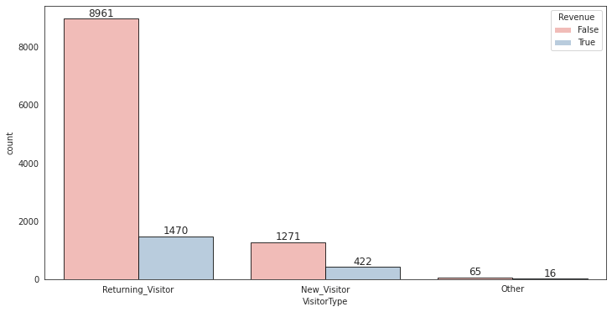

3. Visitor Type Feature:
85% of customers are Returning visitors,
which is a good indicator that may mean
our customers are satisfied with our products.
13.74% of customers are new customers.

Slide 8
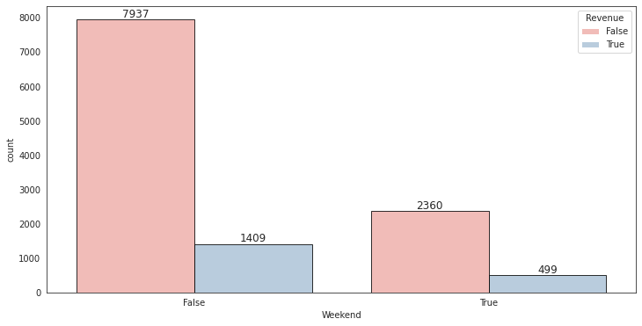

4. Weekend Feature:
Around 77% of visitors visit our site
during weekdays rather than weekends.

Slide 9
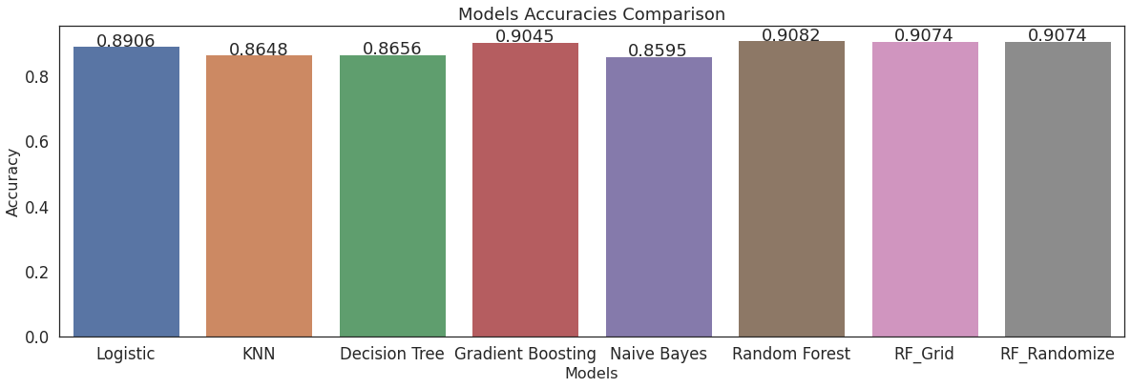
Models Used:
Result:
Random Forest Classifier has 91% accuracy score with and without hyperparameter optimization which is the highest accuracy score over all other models.

Slide 10
Thanks For Listening

